Slide 1

P5-NPOI: The Fast Delay Line Vacuum Interface System
Client: Jim Clark, Director and Chief Engineer
P5 Team Members:
Dustin Haines
Bradley Kingsley
Trung Son Nguyen

Slide 2

The Navy Precision Optical Interferometer
A Naval Research Laboratory Site
Astronomical Long-Baseline Optical Interferometer
Unique Capacity to for detecting and determining motions and orbits of single and binary star systems
Many key features require routine maintenance or repair:
  Fast Delay Lines
  Metrology System
  Optical feed System
  Siderostats

Slide 3
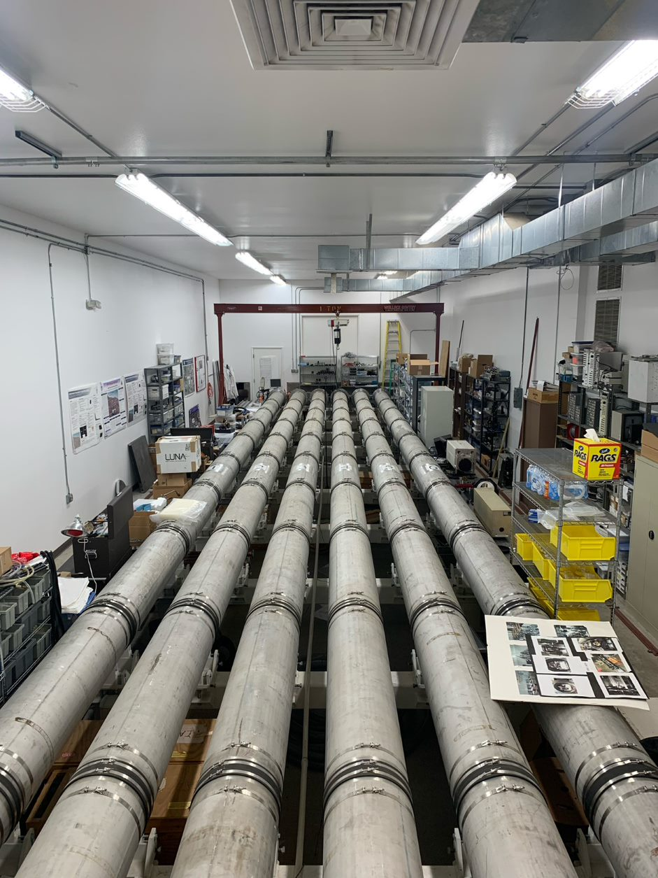
The Fast Delay Lines
(FDL's)
Contains an optical cart system which allows for zeroing of optical path length differences
Key aspects:
  Optical Carts
  Metrology System
  Held Within 10’s on nanometers
  FDL Length = 20 meter
Tanks are held in a moderate vacuum (~10mTorr)
Optical surface positioning is completed using:
  Stepper Motors (Coarse)
  Voice Coils (Moderate)
  Piezoelectric Stacks (Fine)

Slide 4
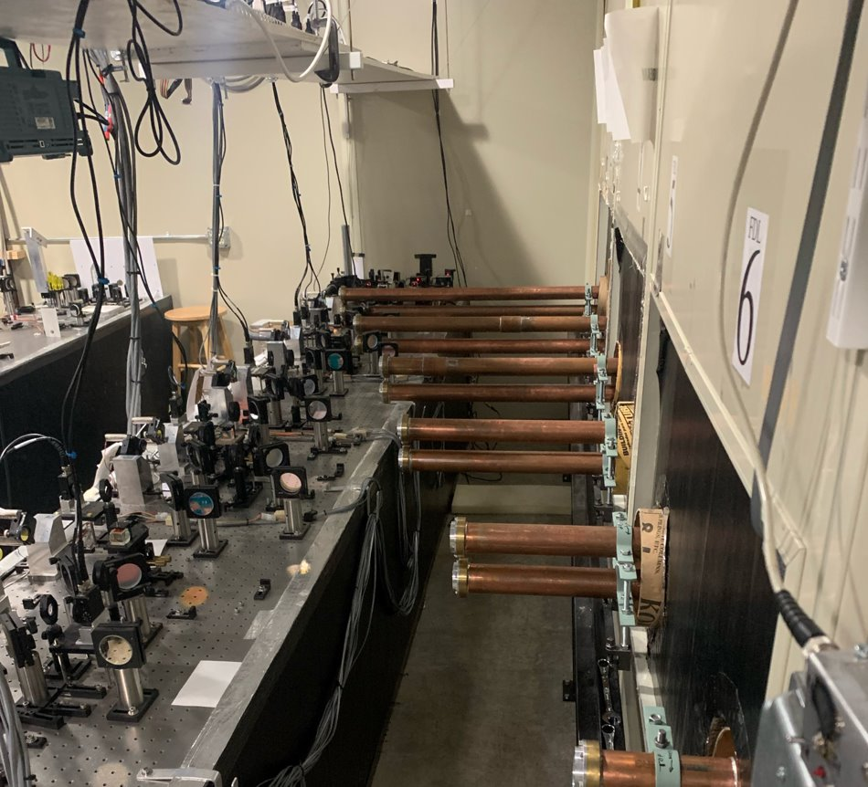
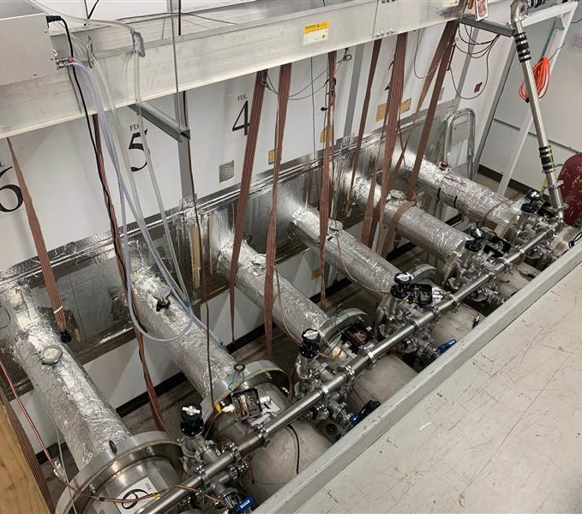
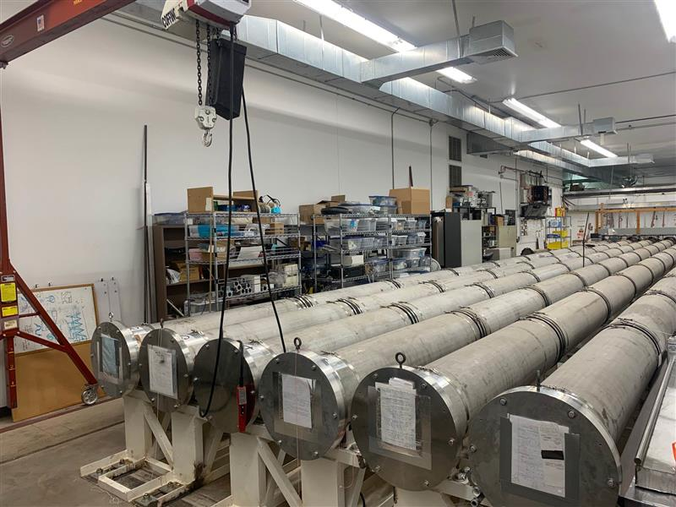
The Current Vacuum Interface
6 Fast Delay Lines in total
2” Thick aluminum or 1” thick stainless steel seal plates
  22 Inch diameter (Front & Rear)
  Requires gantry crane for safe removal
  ~100 Pounds each
Full length copper vacuum tubes (snoots)
  Allows for air-path difference correction
  Transfers axial vacuum force onto seal plates
Simple vacuum tube adjustment stands
  Allowing beam path to be un-clipped
  Small vertical and horizontal adjustment (~0.125”)

Slide 5
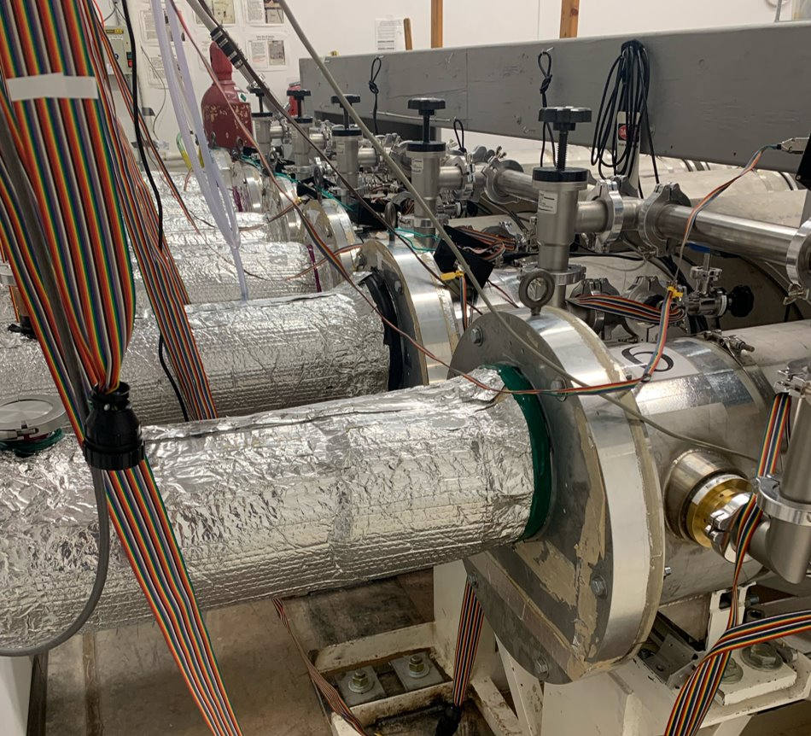
The Problem
Extensive disassembly – reassembly per tank:
  Front ~6-8 hours
  Rear ~2-3 hours
  Costly maintenance/repair time
Metrology optics damage risk
2-3 Technicians and gantry crane required
Re-alignment required upon each full or minor disassembly

Slide 6
Project Requirements
Design lightweight front & rear seal plates
  < 35 Pounds
  Simple removal
Allow stellar & metrology light in/out of system
  Unclipped beams
  Unattenuated (zero light loss)
  No wave front quality issues
Updated sectional snoot design
  Sectioned removal without full snoot tube removal
  Lower metrology optics risk
  Quick connect snoot sections
Snoot adjustment ability
  Translation (vertical & horizontal)
External light cover
  Seals from stray light & air motion/transfer

Slide 7
Engineering Specifications
Seal plates less than 35 pounds
Disassembly in under 1 hour
Seals tanks in vacuum (1 mTorr) & atmosphere (14.7 PSIA)
Snoot pipe X/Y adjustment of ±0.50 inch
Seal plate deformations less than 0.010 inch
Drift less than 0.010 inch per month
At least 2 sight ports on rear seal plate
Uninterrupted light input/output

Slide 8
Mid-Project Modifications
Due to partner transitions:
  Site access past January 1, 2023, was not allowed
  All hardware & material was inaccessible
Project modification plan included:
  35% Scale prototype of the interface system (3D printed)
    FDL #1 & FDL #6
  The following original requirements were not possible to test:
    Disassembly in less than 1 hour
    Seals to vacuum & atmosphere
    Drift less than 0.010 inch

Slide 9
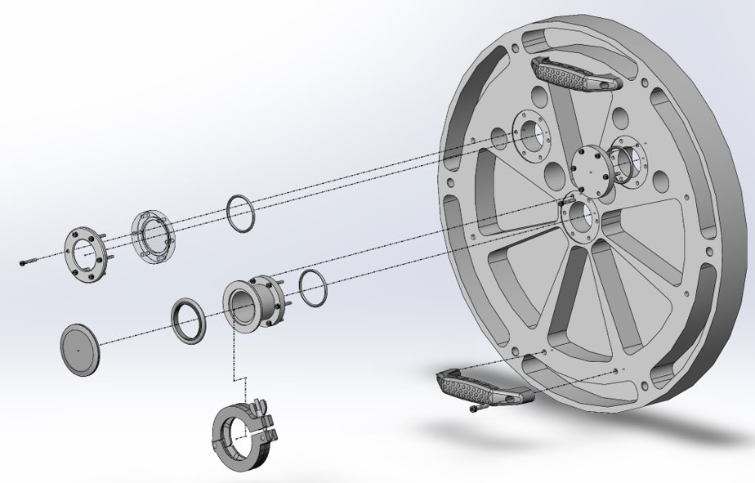
Rear Seal Plate Design
Rear seal plate weight = 33.9 pounds
Maximum deflection under vacuum of -0.0049 inch
  Finite element simulation
3 Options for port attachments:
  Polycarbonate vacuum window
  Solid port blanking plate
  Quick flange vacuum attachment

Slide 10
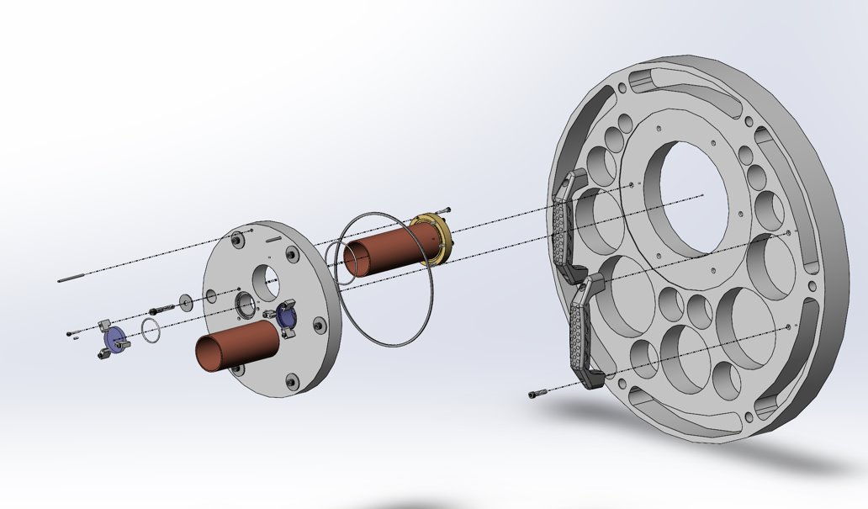
Front Seal Plate Design
Front seal plate weight = 34.2 pounds
Maximum deflection = -0.0037 inch
  Finite element simulation
Adjustable front snoot plate attachment
  ±0.25”
Updated metrology window design
Fixed snoot section for attachment

Slide 11
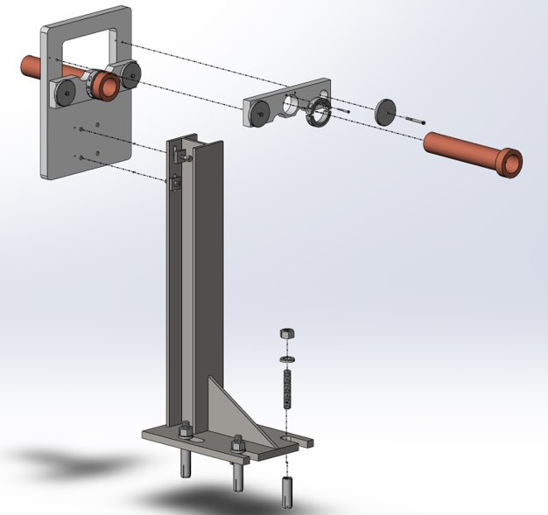
Snoot Stand & Adjuster Design
Rigid support structure
Sectioned snoot with air path piston adjustment
2 Vertical adjustments
  ±1.25”
1 Horizontal adjustment
  ±0.50”

Slide 12
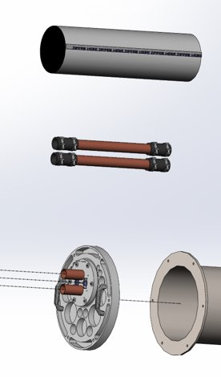
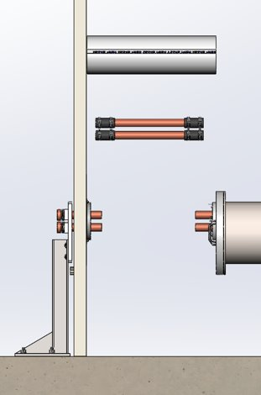
External Light Cover Design
Replaced old aluminum foil light cover
Blackout fabric
Attached Velcro to fabric and snoot plate
Decreases assemble/disassemble time

Slide 13

Sectional Snoot Design
Snoots are sectioned into 3 Parts:
  Front seal plate fixed section
  Intermediate section
  Snoot stand fixed section
Intermediate section can be removed
  No effect on other snoot pipe alignment
  Simple sealing tube connection removal
2
1
3

Slide 14
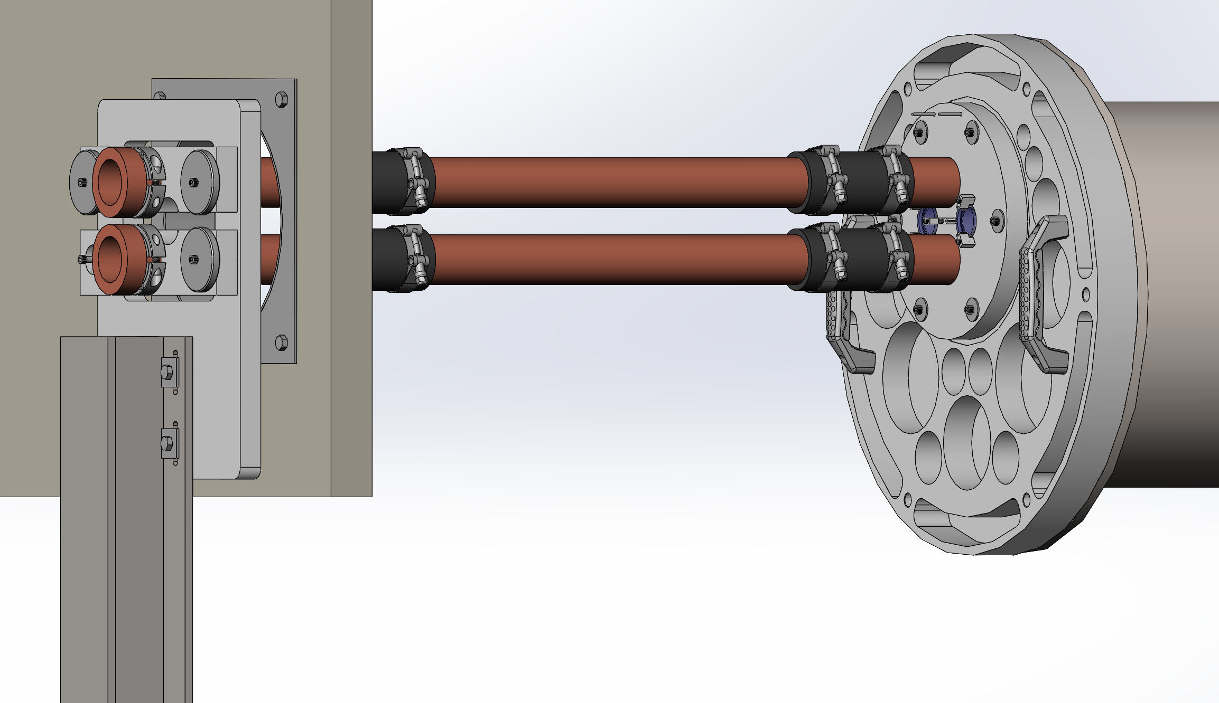
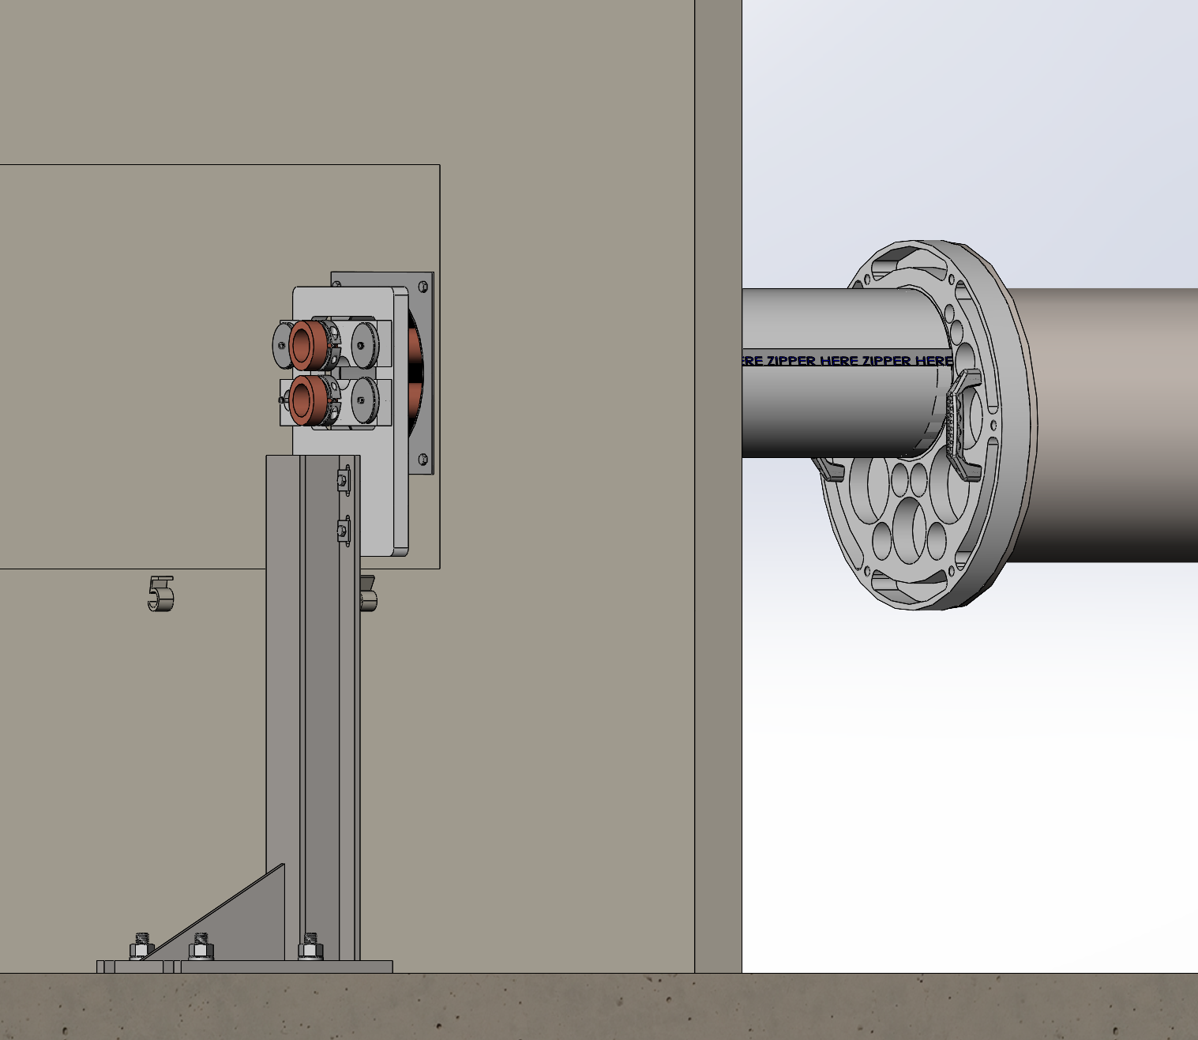
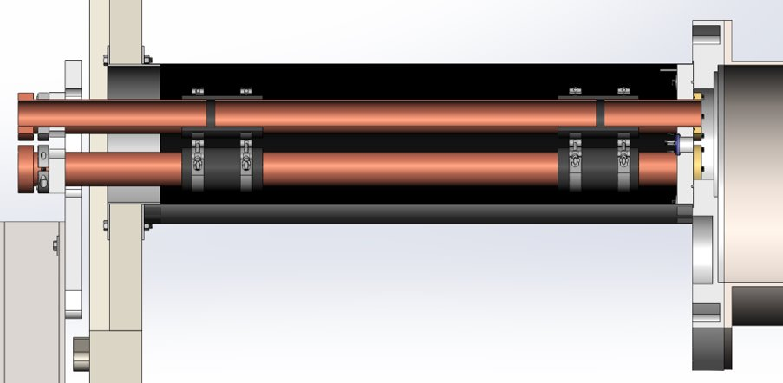
Final Assembly of Design & Prototype

Slide 15

Decision Making
Focused on fulfilling customer requirements
Had weekly meetings to consult with client to involve client throughout each aspect of design
Calculations and simulations
Iterative process

Slide 16
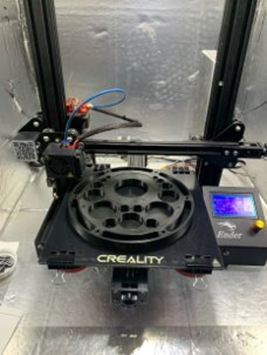
Manufacturing Plan & Execution
Creality Ender 3 Pro used for prototype printing
  Polylactic Acid (PLA) material
  Cura model slicer
  0.4 mm nozzle @ 0.2mm layer height
Prototype attachment methods:
  Super glue for PLA-to-PLA joints
  Screws for adjustable parts
  Pins for removable parts
  Double sided tape for base connection

Slide 17
Testing Plan Execution
Experiment/Test​ | Relevant Design Requirement​
Front Seal Plate Weight​ | CR/ER 1​
Rear Seal Plate Weight​ | CR/ER 1​
Front Seal Plate Deflection​ | CR/ER 5​
Rear Seal Plate Deflection​ | CR/ER 5​
Snoot Plate Adjustment​ | CR/ER 4​
Snoot x/y Adjustment (combined)​ | CR/ER 4​
Rear Seal Plate Sight Port Count​ | CR/ER 7​
Allow Laser in & out of Scaled System​ | ER 8 (NEW, allow light into and out of the system without clipping. Allow full adjustment of parts)​
Testing plan was made based on the customer requirements
Testing process made through SolidWorks simulation and prototype measurement

Slide 18
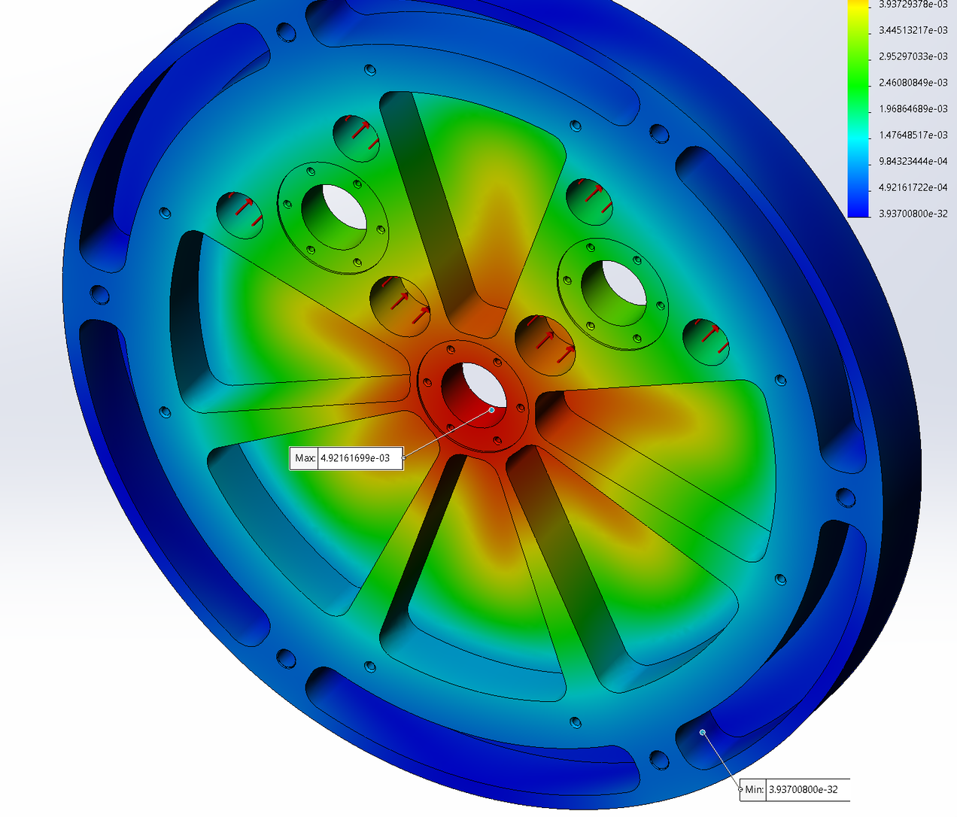
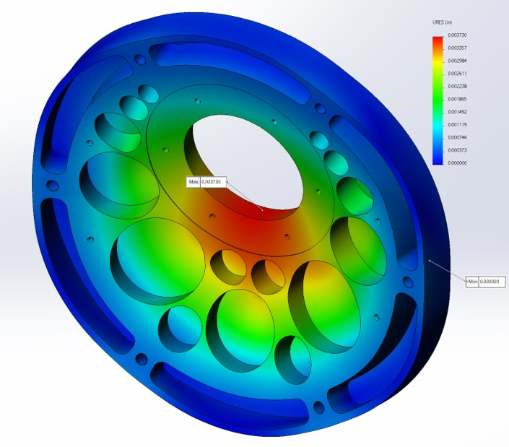
Testing Result
From SolidWorks analysis, the final weight for front and rear seal plates are:
  34.18 pounds (front)
  33.91 pounds (rear)
The deflection of seal plates are within the required range from client;
  0.00373 inch (front)
  0.00492 inch (rear)

Slide 19
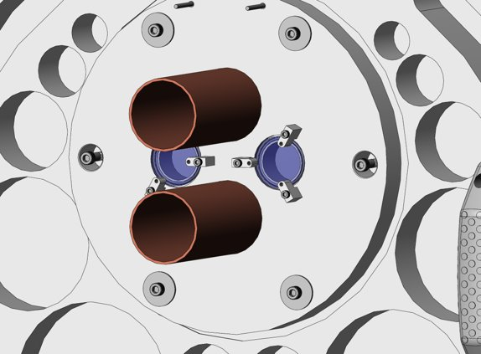
Testing Result (Snoot Adjustment)
At full scale, snoot can move 0.5" in x & y directions
For the prototype requirement, the adjustment must be greater 0.175"
Result: snoot adjustment can move 0.19"

Slide 20

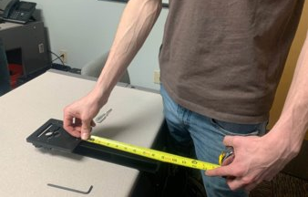
Testing Result (Stand Adjustment)
Christmas tree and snoot adjustment combined adjustment
  Christmas tree vertical found:
    Max – Min = Adjustment length
    Bilateral length of adjustment = ±0.3125” = ± 5/16”
  Snoot adjustment plate (vertical):
    Max – Min = Adjustment length
    Bilateral length of adjustment = ± 0.125” = ± 1/8”
  Snoot adjustment plate horizontal:
    Max – Min = Adjustment length
    Bilateral length of adjustment = ± 0.125” = ±1/8”
  Full vertical range = 0.4375” = 7/16”
  Full horizontal range = 0.125” = 1/8”

Slide 21
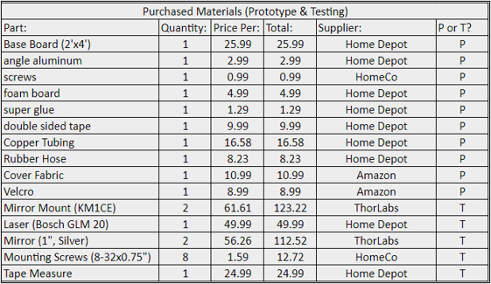

Budget Consideration of Prototype
All parts and components for prototype and testing plan on hand (delivered)
Prototype materials
Testing plan materials
Total cost includes:
  All filament
  All purchased hard parts
  Prototype materials
  Testing materials

Slide 22

Future Work
NPOI site access is slowly returning for the NPOI team
The following will be developed this summer for NPOI:
The NPOI Opto-Mechanical Group is eager to implement these designs for:
  Functional use of the FDL's
  Reduced maintenance & repair time
  Easier disassembly & reassembly

Slide 23
Special Thank You
Jim Clark – Director and Chief Engineer
Project Client
Valuable Engineering Calculation Support
The Naval Research Laboratory
Site Funding Stream
Continued Support to the Capstone Team
Current NPOI Opto-Mechanical Group
Valuable Current System Needs Input
Valuable Design Review Input
Valuable Engineering Calculation Support

Slide 24
Question Or Comments

